Slide 1
Gut microbia dysbiosis in animal models
and human populations
Dr. Anthony Fodor
Associate Professor
Department of Bioinformatics
The University of North Carolina at Charlotte

Slide 2
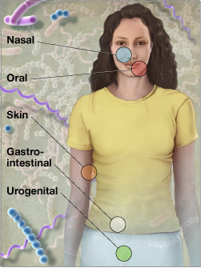
Microbes run the world!
There are 10 times more microbial
cells in our body than human cells
There are 100 times more genes
in those microbes than human genes
http://www.genome.gov/images/feature_images/nr_hmp.jpg

Slide 3
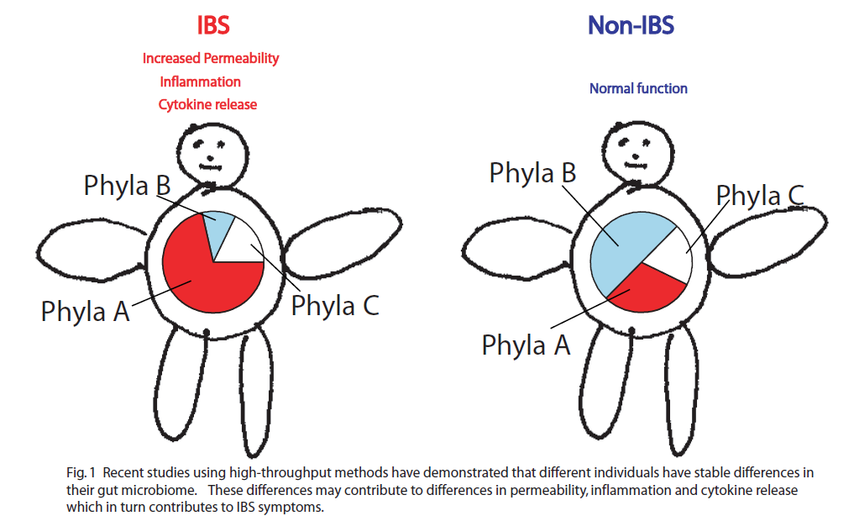
How does the microbial community impact disease? (2011)

Slide 4
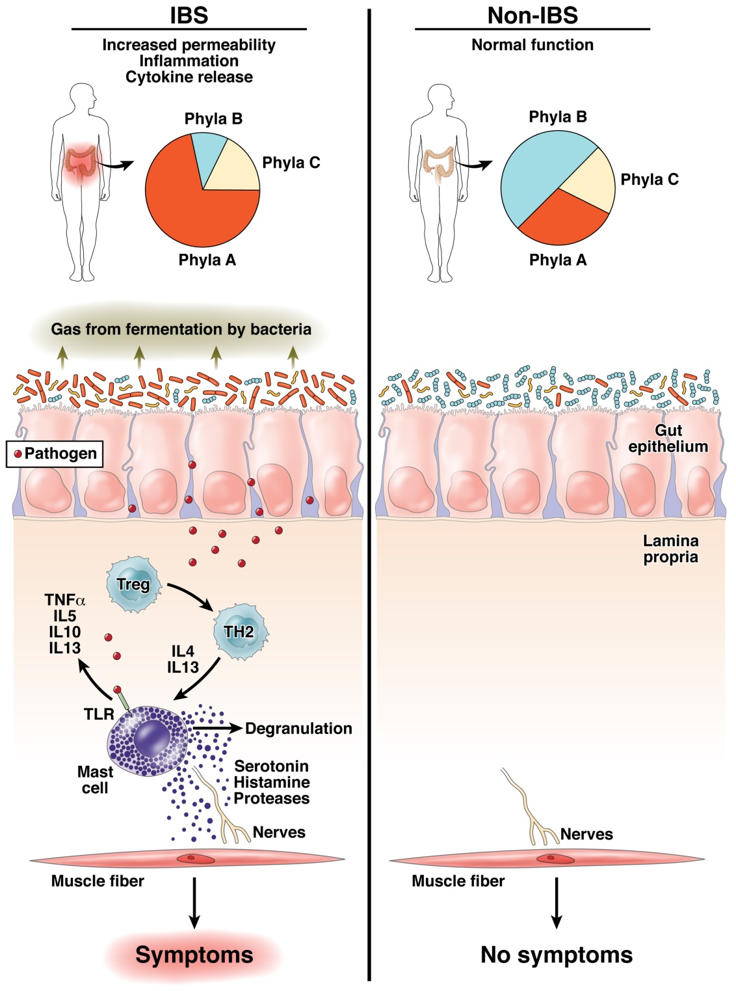
The “dysbiosis hypothesis” is central to our thinking about the role of the
microbiome in human health
Fodor & Talley. Gastroenterology. 2011

Slide 5
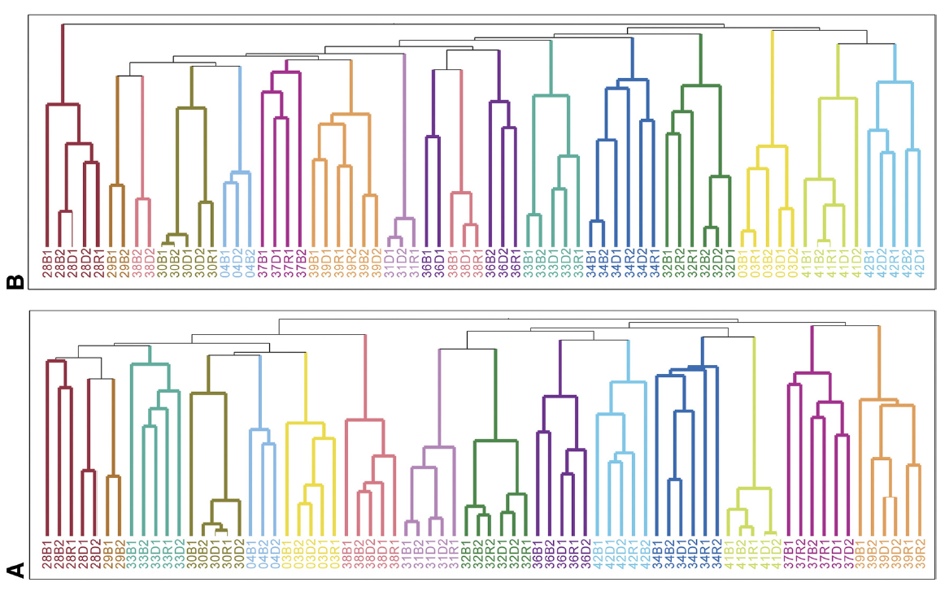
How easy it to change a microbiome?
The gut microbiome is individual, stable over time and surprisingly resistant to short-term changes in diet…
Spencer et al, Association between composition of the human gastrointestinal microbiome and development of fatty liver with choline deficiency,2011

Slide 6
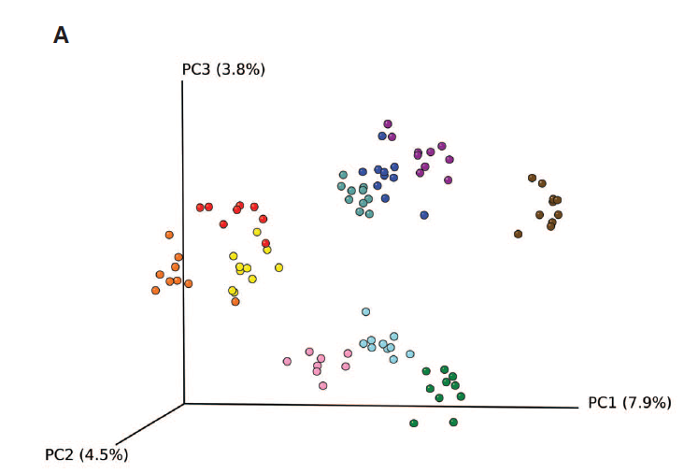
The gut microbiome is individual, stable over time and surprisingly resistant to short-term changes in diet…
Wu et.al - Linking Long-Term Dietary Patterns with Gut Microbial Enterotypes, 2011

Slide 7
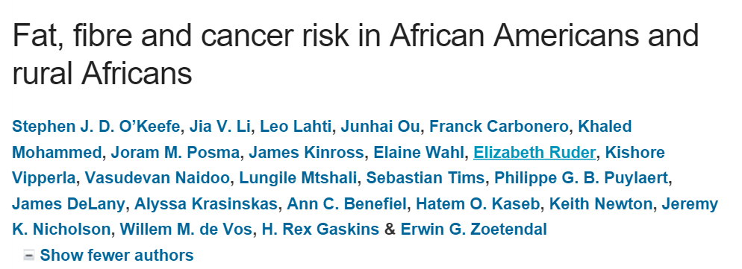
The gut microbiome is individual, stable over time and surprisingly resistant to short-term changes in diet…
Health benefits of changing diet may not be associated with big 16S changes in the microbiome!
“food changes resulted in remarkable reciprocal changes in mucosal biomarkers of cancer risk”
“the compositional changes that were specifically associated to the diet switch were minor”.

Slide 8
How important is microbial community composition?
Microbial community composition is strongly associated with obesity…

Slide 9

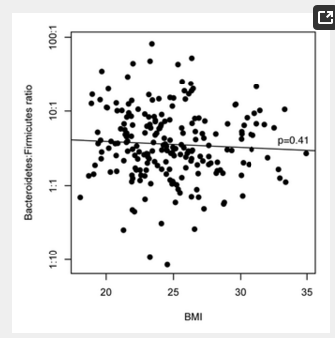
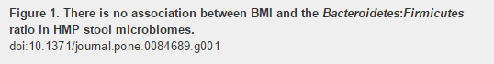
How important is microbial community composition?
Microbial community composition is strongly associated with obesity…
…. except that it never seems to be…

Slide 10
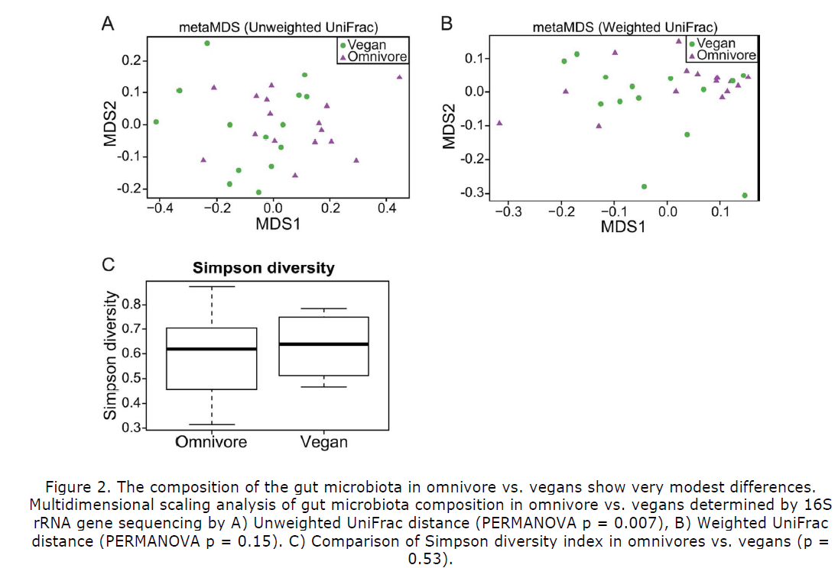
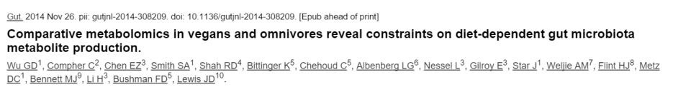
The microbiome of vegans is pretty similar to omnivores…

Slide 11
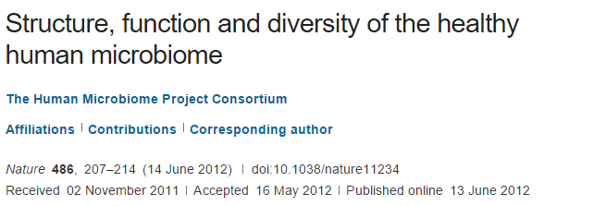
“We conclude that most variation in the human microbiome is not well explained by … phenotypic metadata, and other potentially important factors such as short- and long-term diet, daily cycles, founder effects such as mode of delivery, and host genetics should be considered in future analyses.”

Slide 12
Refined “dysbiosis hypothesis” (2015)
There are many, many
alternative, healthy
microbiome configurations;
Healthy variation is not
driven by the microbiome
Your individual microbiome is not so easy to change (at least with diet)
There are fewer dysbiotic states ;
Disease states can be
driven by the microbiome
Opposite of Anna Karenina
Fodor & Talley. Gastroenterology. 2011

Slide 13
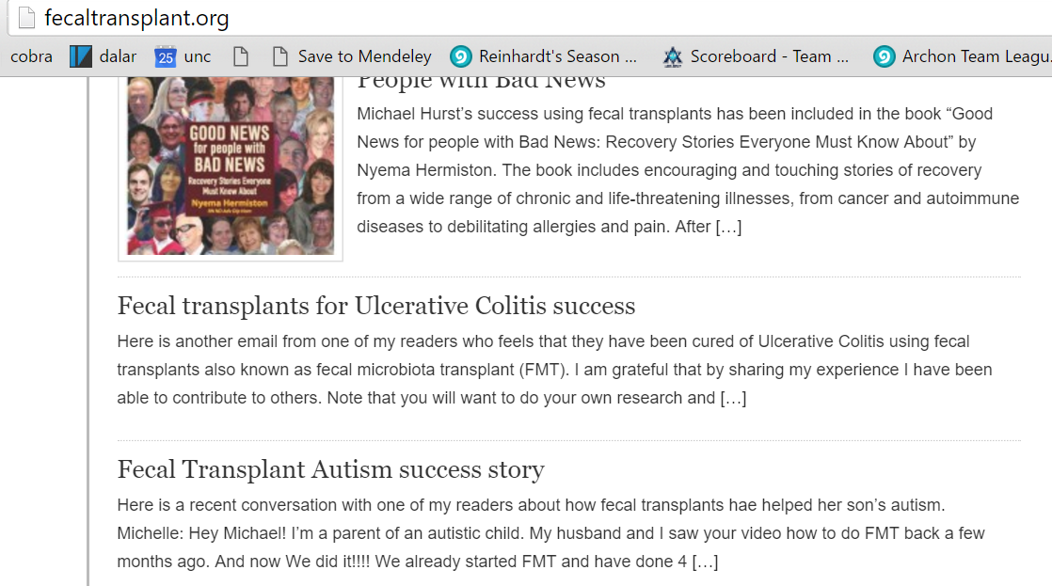
Establishing what is and is not directly driven by the microbiome is becoming increasingly urgent
Negative result are very important!

Slide 14

Establishing what is and is not directly driven by the microbiome is becoming increasingly urgent
Negative result are very important!

Slide 15

Establishing what is and is not directly driven by the microbiome is becoming increasingly urgent
Negative result are very important!

Slide 16
An example of dysbiosis defined by one pathogen

Slide 17
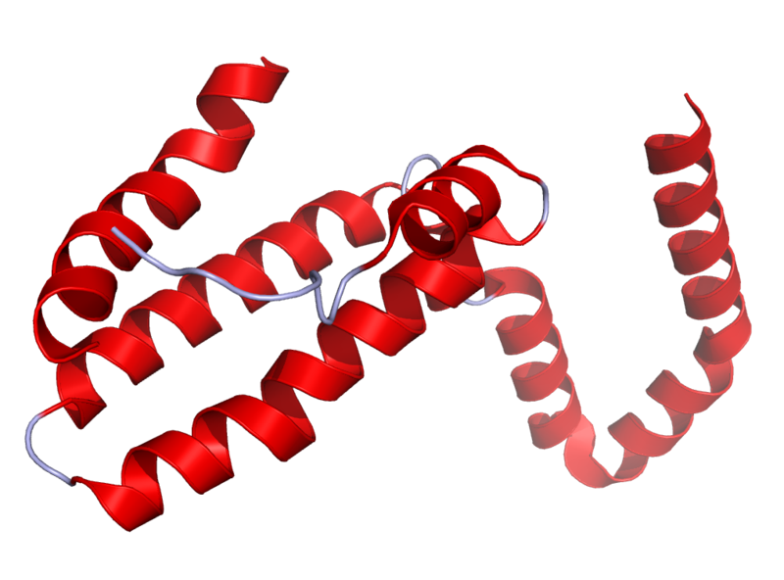
Il10^{-\-} Mouse Model
Il10 is an anti-inflammatory cytokine.
Inhibits pro inflammatory cytokines
Acts as an immunoregulator in the GI tract.
Lamblin, C., et al.,The Journal of allergy and clinical immunology, 2001.
http://en.wikipedia.org/wiki/Interleukin_10
Il10-\-
Il10^{-\-} mice are prone to inflammation with commensal tolerated by WT mice.
Knoch, B., et al.,Microbiology-Sgm, 2010
Established model for investigating disease phenotypes associated with inflammation

Slide 18
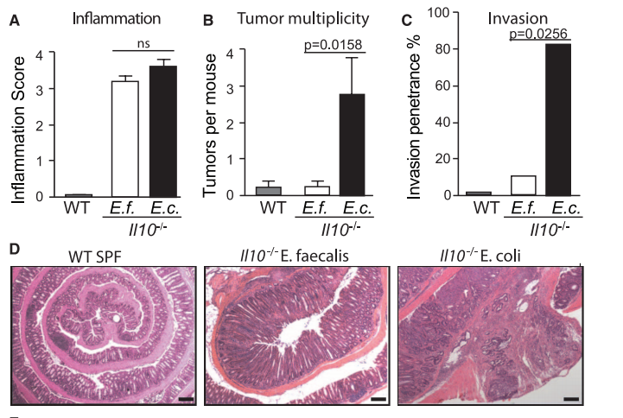
Some bugs, but not others, can cause inflammation to progress to cancer…
Arthur et al, Science, 2012

Slide 19
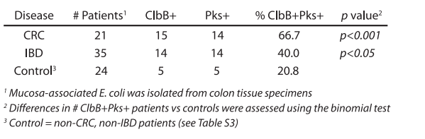
The presence of PKS is associated with cancers in multiple human cohorts

Slide 20
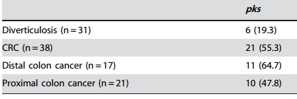
The presence of PKS is associated with cancers in multiple human cohorts
Buc et al - High Prevalence of Mucosa-Associated E. coli Producing
Cyclomodulin and Genotoxin in Colon Cancer (2013)

Slide 21
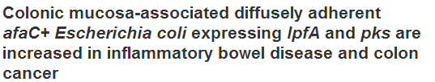
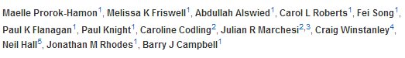
The presence of PKS is associated with cancers in multiple human cohorts
The presence of PKS is associated with cancers in multiple human cohorts
Buc et al - High Prevalence of Mucosa-Associated E. coli Producing
Cyclomodulin and Genotoxin in Colon Cancer (2013)

Slide 22
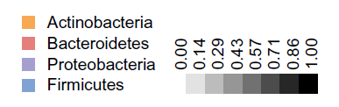
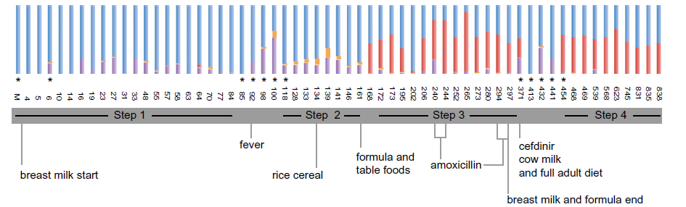
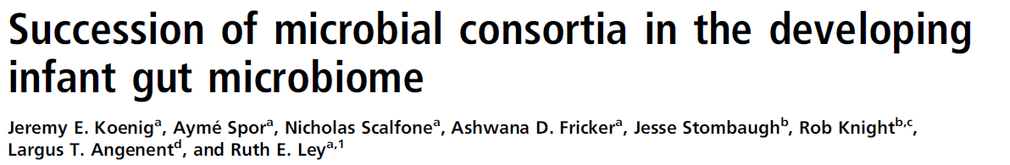
Proteobacteria selected against over time can be seen in human samples

Slide 23
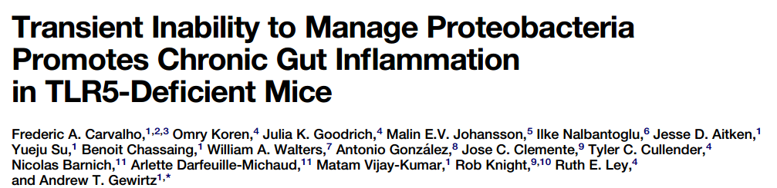
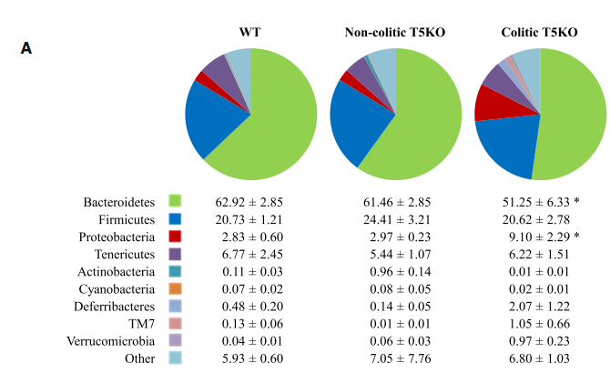
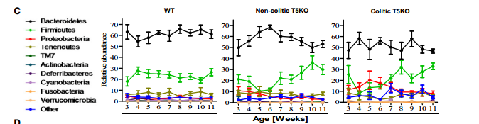
Inflammation interfering with normal succession is an emergent theme in the literature..

Slide 24
Does Westernization promote dysbiosis?

Slide 25


A related hypothesis to the dysbiosis hypothesis: the “lost microbiome” hypothesis.
Our modern Westernized microbiome is part of what contributes to disease.
We have lost beneficial bugs which we had evolved with and not have less helpful bugs…

Slide 26
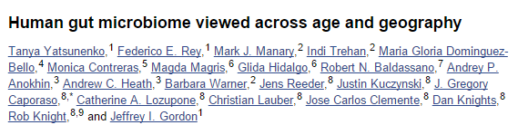
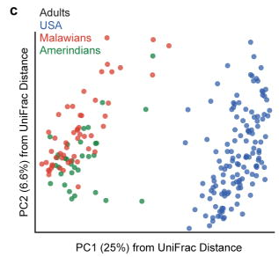
Certainly, non-Western microbiomes are very different from Western microbiomes
“healthy Amerindians from the Amazonas of Venezuela, residents of rural Malawian communities,
and inhabitants of USA metropolitan areas”

Slide 27
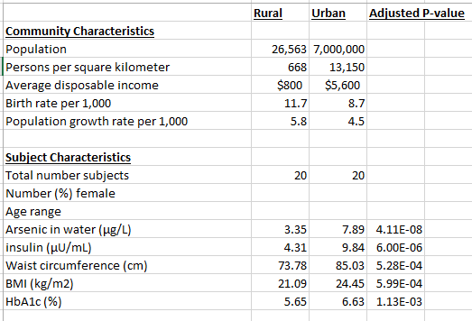
Neighboring regions in Hunan province have very different characteristics
Kathryn Winglee, Annie Green Howard, Penny Gordon-Larsen, manuscript in preparation

Slide 28
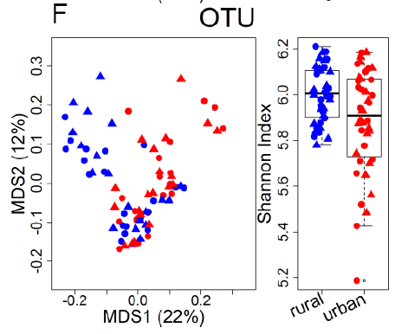
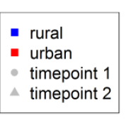
To the list of differences, we can add differences in the microbiotia
Kathryn Winglee, Annie Green Howard, Penny Gordon-Larsen, manuscript in preparation

Slide 29
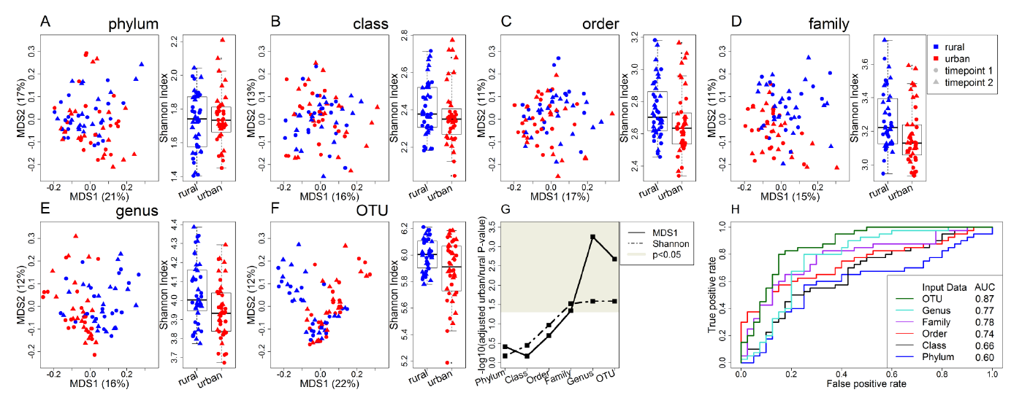
Differences constrained to lower levels of the evolutionary tree provide evidence of niche selection

Slide 30
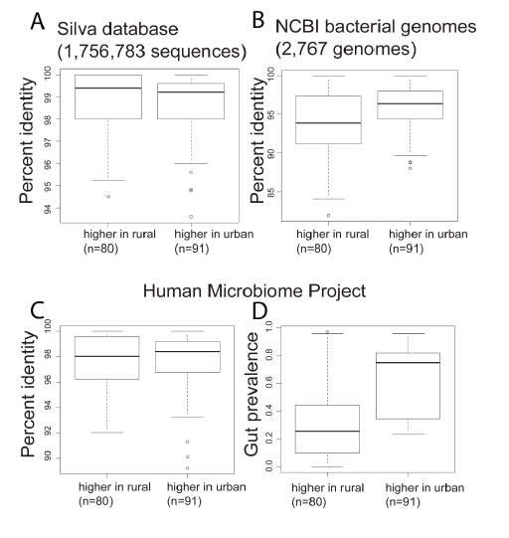
Bugs in rural China are less like U.S. bugs (and are not as well studied)

Slide 31
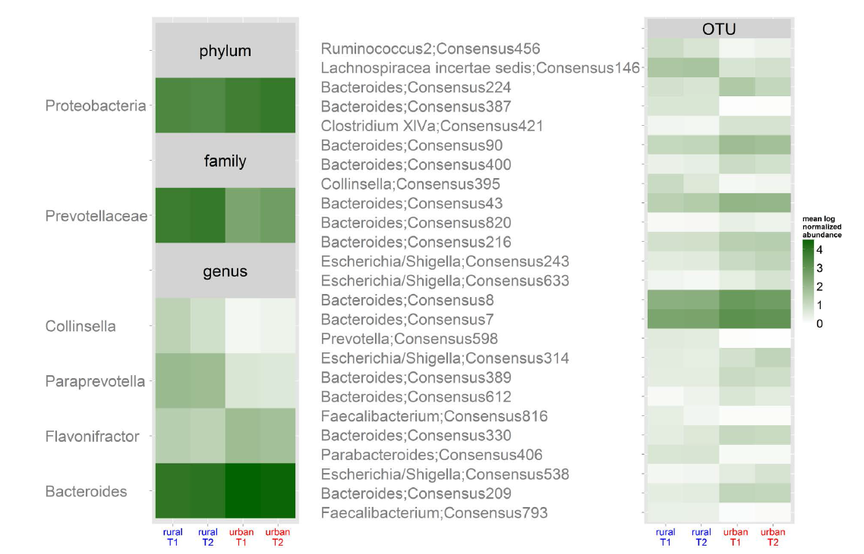
Among the bugs that are higher in urban China is genus Escherichia

Slide 32
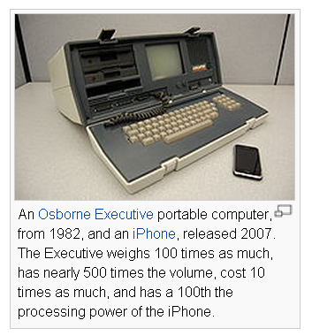
Computer then and now…
What will microbiology look like when we
can carry around whole-genome microbiome
samplers in our hand?
Will there be an iPhone sequencing app?
If you can sequence them in real time,
microbes are no longer invisible…
http://en.wikipedia.org/wiki/Moore's_law

Slide 33
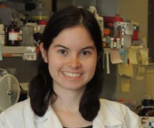











Acknowledgements
UNC-Chapel Hill
Janelle Arthur
Annie Green Howard
Marcus Muhlbauer
Penny Gordon-Larsen
UNC-Charlotte
Ra’ad Gharaibeh
Jon McCafferty
Kathryn Winglee
UF- Gainesville
Christian Jobin
Kathryn Winglee
Annie Green Howard
Penny Gordon-Larsen
Raad Gharaibeh
Jon McCafferty
Marcus Muhlbauer
Janelle Arthur
Christian Jobin

Slide 35
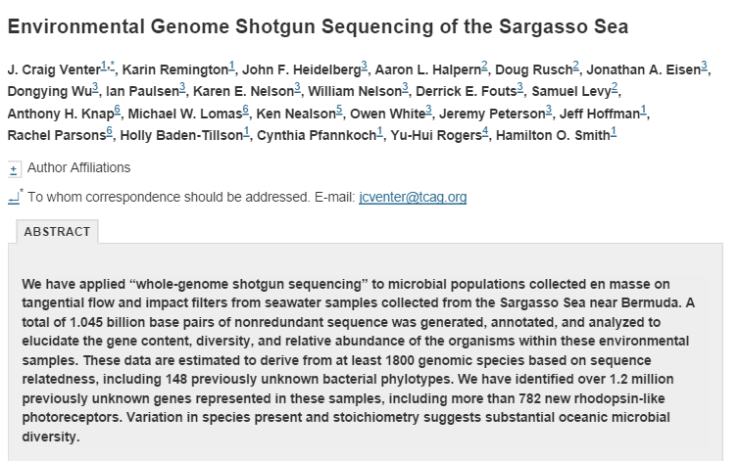
What have we learned in the last 5-7 years as sequencing has gotten cheap?
Microbial communities are complex….

Slide 36
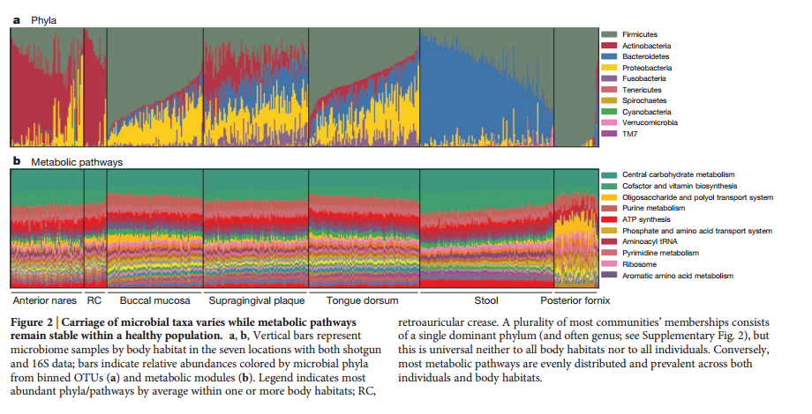
16S variation is not necessarily reflected in whole-genome variation…

Slide 37
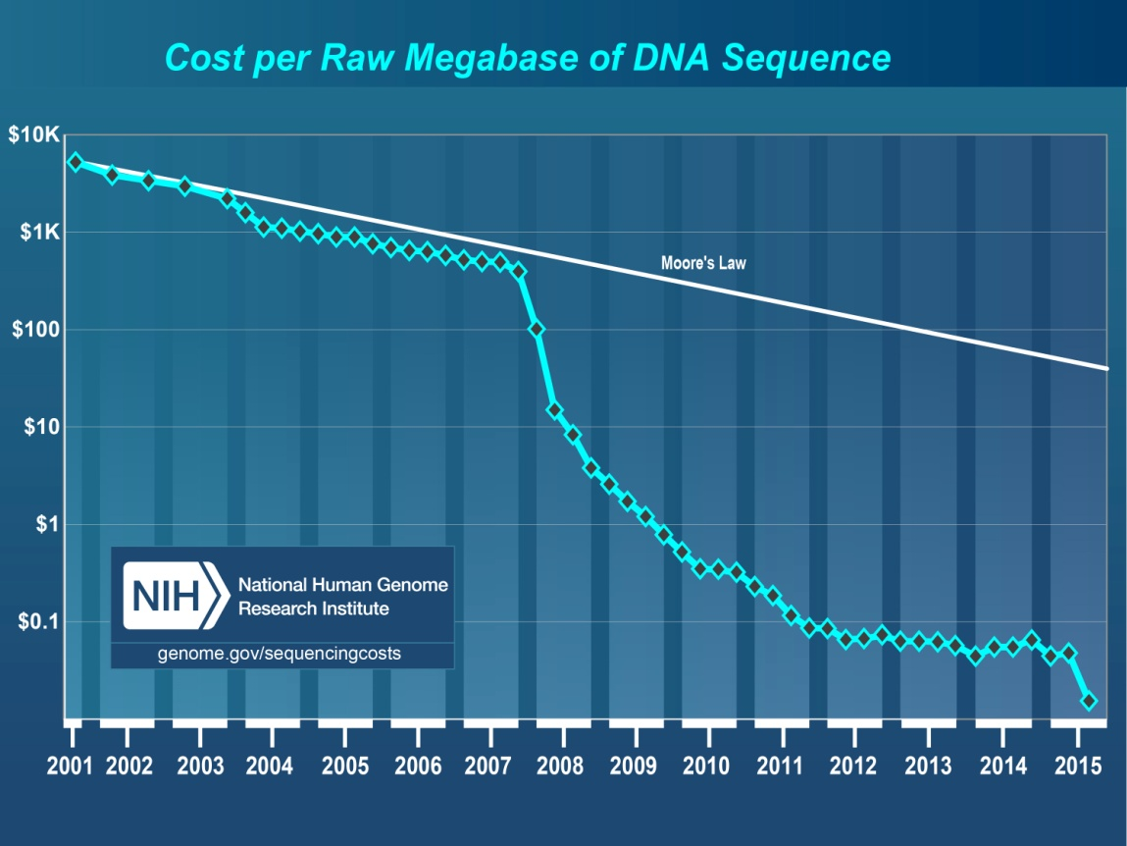
Progress in describing complex communities is driven by new technology
http://images.forbes.com/media/2010/06/03/0603_chart-cost-human-genome_398x371.jpg
What have we learned in the last 5-7 years as sequencing has gotten cheap?

Slide 38
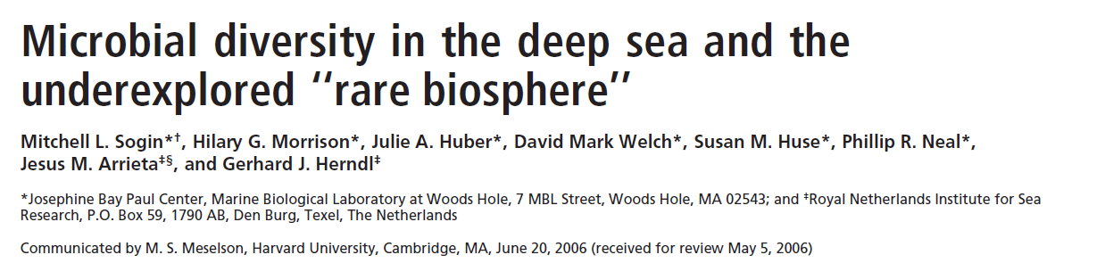
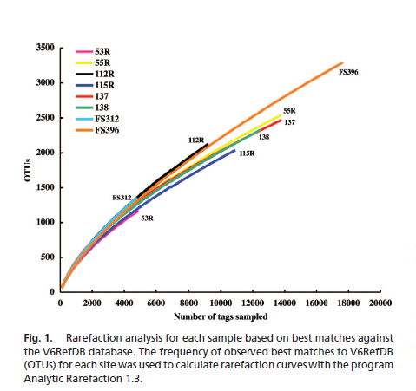
What have we learned in the last 5-7 years as sequencing has gotten cheap?
Microbial communities are complex….

Slide 39
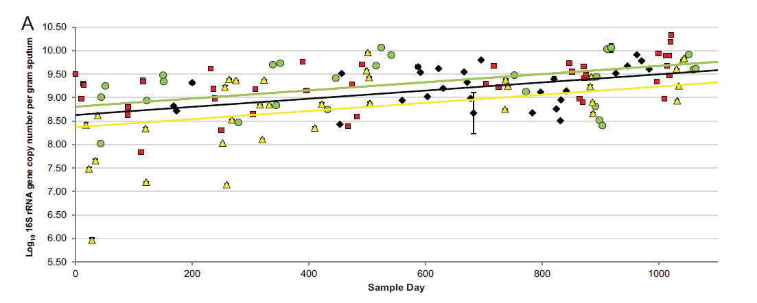
Longitudinal sampling is very important

